Slide 1

DIGIGRAD
When entering teams, have a look at the chat of the session!
Karine Hindrix
Diversity for strong collaboration
Online Teams meeting
17th September 2025
Notes:
Gebruik deze slide als front page voor je presentatie

Slide 2

Context
DIGIGRAD-project: internationalization in Higher Education
My experience and professional/life world is mainly Western European
Who am I?
Teacher educator / researcher @www.UCLL.be
Behavioral sciences (pedagogy/psychology)
Political sciences
Experience in internationalisation

Slide 3
Learning outcomes
To identify various characteristics in which people can differ and their possible effect
To name factors of success and difficulties in group work
To identify three things to build relationships in a group work
To make room for divergent thinking in group work
To make (diverse) thinking visible
To explain how the wisdom of the whole group can be used
To have courage to address difficulties/conflict
To assess the input here for your context

Slide 4
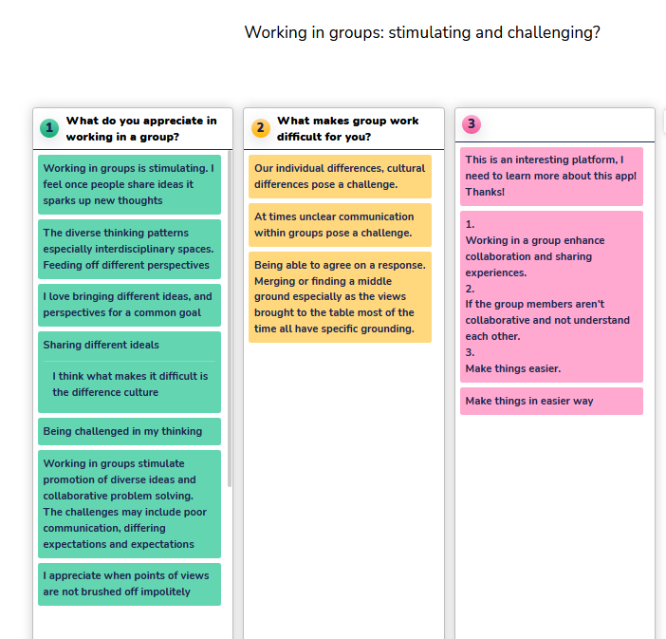
Collaboration in groups: stimulating and challenging?
Check in
Diversity
Investing in relationships
Divergent thinking
Making thinking visible
Using the wisdom of the minority
Conflict
Wrap up
Tool used: www.wooclap.com
Notes:
Aangeven dat het anoniem is
Pas laten zien als er antwoorden zijn

Slide 5
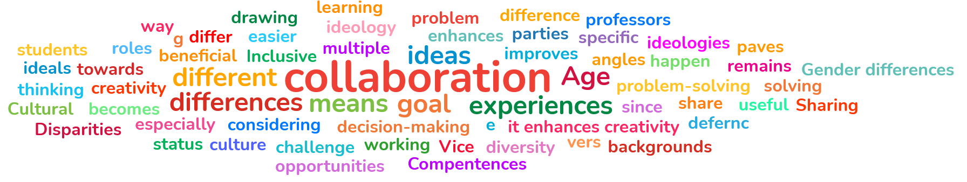
Diversity in collaboration
Check in
Diversity
Investing in relationships
Divergent thinking
Making thinking visible
Using the wisdom of the minority
Conflict
Wrap up
Of what does it make you think?

Slide 6
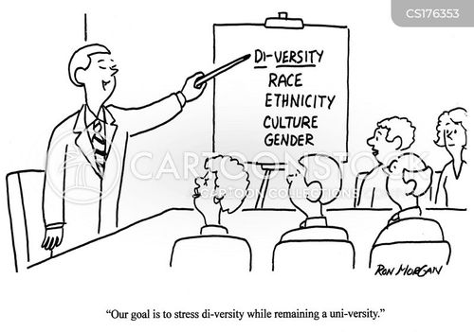
Notes:
Eerst belangrijk om de moeilijkheden te bespreken die diversity met zich meebrengt. Niet alleen maar joy and nice buth it produces effects as well that might block collaboration or at least not get the best out of every group member.

Slide 7
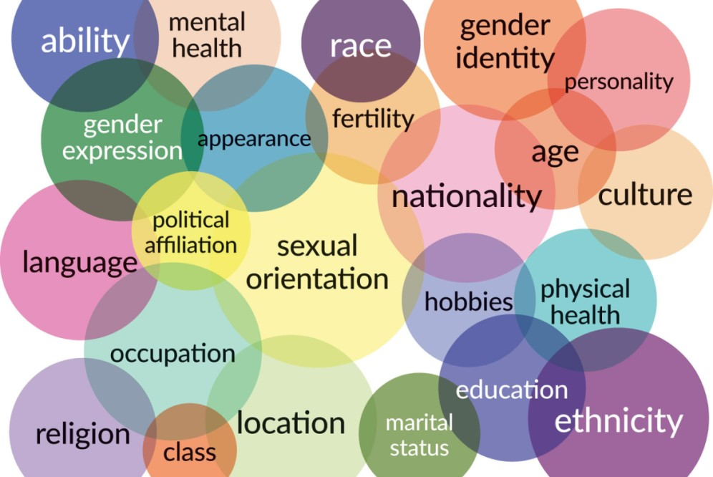
Notes:
Source: https://researchguides.library.syr.edu/fys101/intersectionality

Slide 8
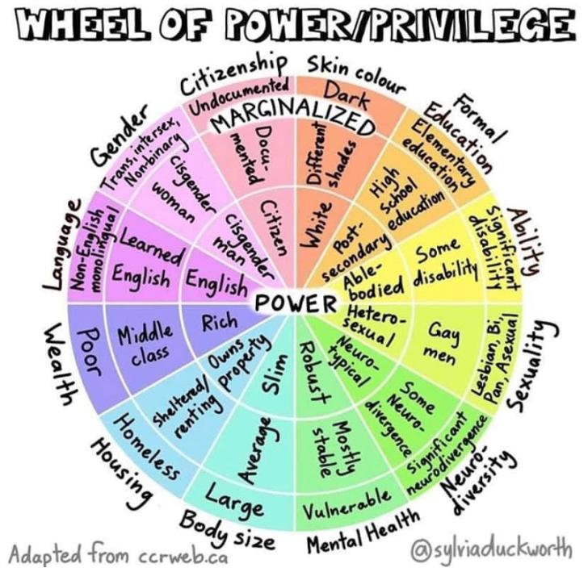

Intersectionality
=> the interconnected nature of social categorizations such as race, class, and gender as they apply to a given individual or group, regarded as creating overlapping and interdependent systems of discrimination or disadvantage.
"through an awareness of intersectionality, we can better acknowledge and ground the differences among us"
JD Kimberly Crensaw https://en.wikipedia.org/wiki/Kimberl%C3%A9_Crenshaw
Notes:
See also, e.g. women in STEM: https://awis.org/
It means also that you can feel closer, more connected to e.g. sombebody from another culture than your own family

Slide 9
YOU will have prejudices
Material features: visible and produce effect
In academia >> When discussing and working in group: what behaviors reinforces / weakens status?
  amount of talking
  contributions to the task
  the way of communicating
  not knowing something
  citing and concept dropping
  reactions of fellow students
  …
(!) be aware of your own prejudices towards fellow students
Invest in going beyond them / postpone judgement
Focus on the work to be done = a group responsibility
Notes:
Sofisticated speaking and writing skills
Mentioning theory and books
(!) the work is not with the other in the first place. Also with you to connect. Look for other reasons of behavior
If you are irritated or let your prejudices rule, it might have to do with expectations.

Slide 10
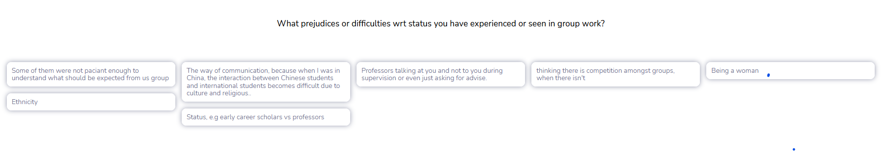
Does this make sense in your context/experience?

Slide 11
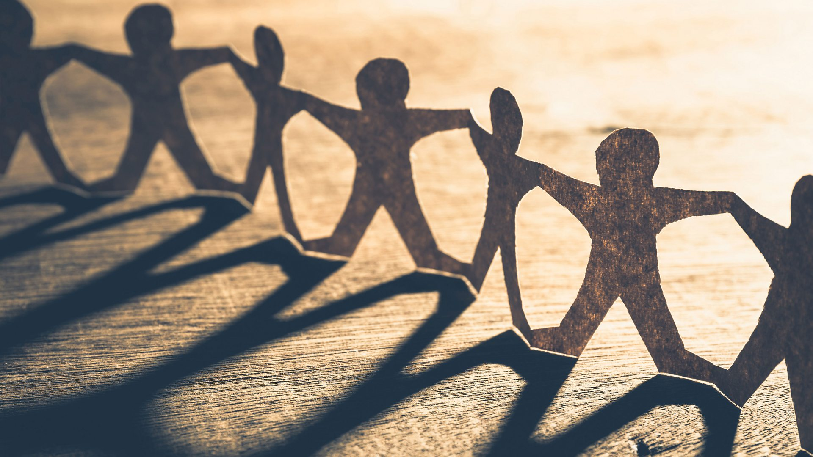
Check in
Diversity
Investing in relationships
Divergent thinking
Making thinking visible
Using the wisdom of the minority
Conflict
Wrap up

Slide 12
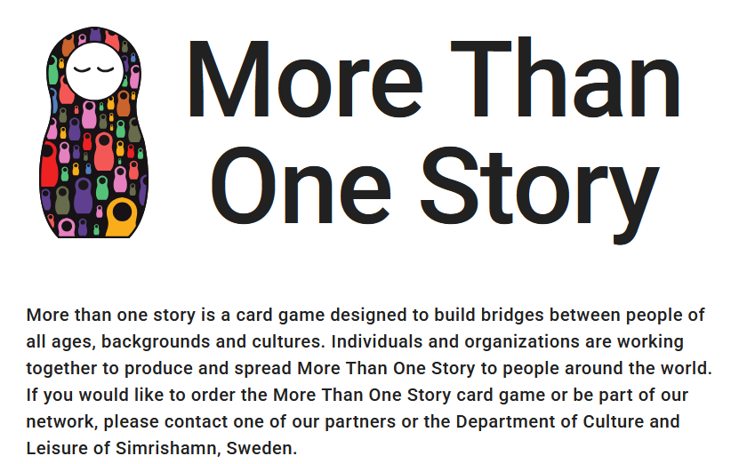
Getting to know each other: stories connect
Tell a story about a moment when you were nervous
Tell a story about a present which you have given or received
Tell a story about a time when you felt lucky
Tell about a film or a book that has influenced you
Tell something about how you played as a child
…
See also the work of Deardorff/UNESCO for intercultural understanding:
https://www.unesco.org/en/interculturaldialogue
Notes:
https://www.morethanonestory.org/en
Invest in creating a shared identity around the group topic

Slide 13
Making expECTations explicit
What does the subject mean to you and your education?
What do you expect from group members? From the way of working? Standards?
Discuss values, e.g. what proverb was important when you grew up?
What does respect mean for you in group work?
What is your aim in this work?
What helps you in group work?
What do you bring into the group work?
For what issue you might have to learn and experience support?
…

Slide 14
Clear working arrangements
Based upon the expectations
Based upon theory of group work/project work (see next session, e.g. making minutes, leadership, …)
What does failure mean for group work and how do we deal with it
…?
Notes:
Vragen naar ervaringen hierrond?

Slide 15
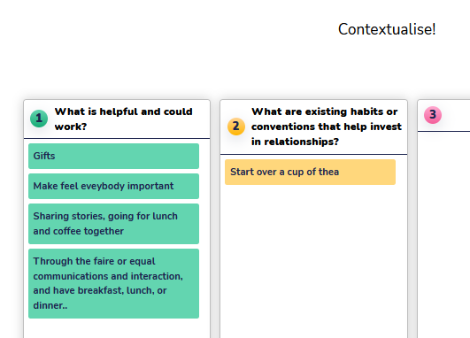
What does that mean in your context?
The informal:
Coffee or tea
Breakfest
Team building activity
…
Familiarity might not be necessary level but it helps build relationship. Ask what members need if they are hesitant to participate in this and explain the value.

Slide 16
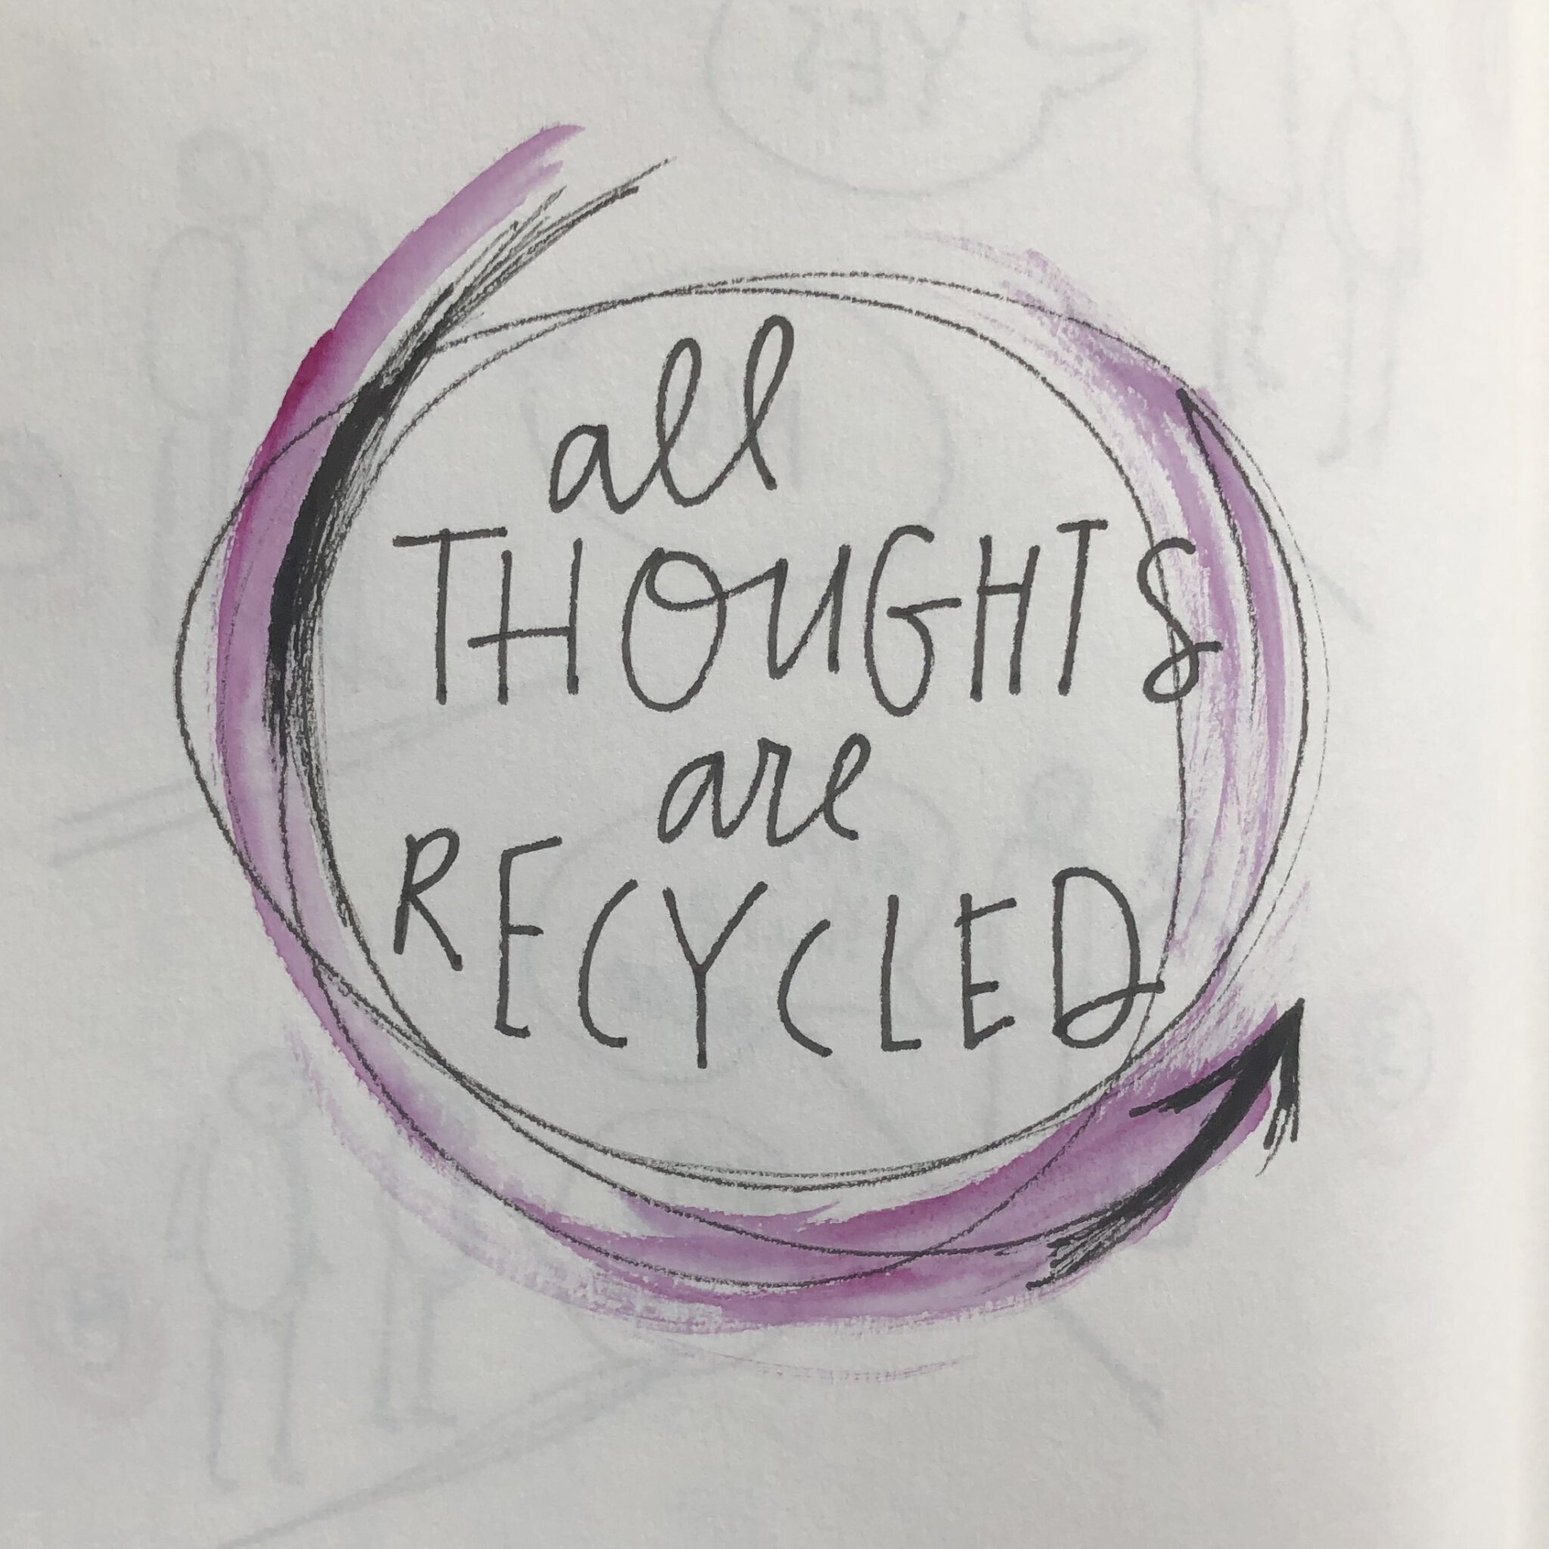
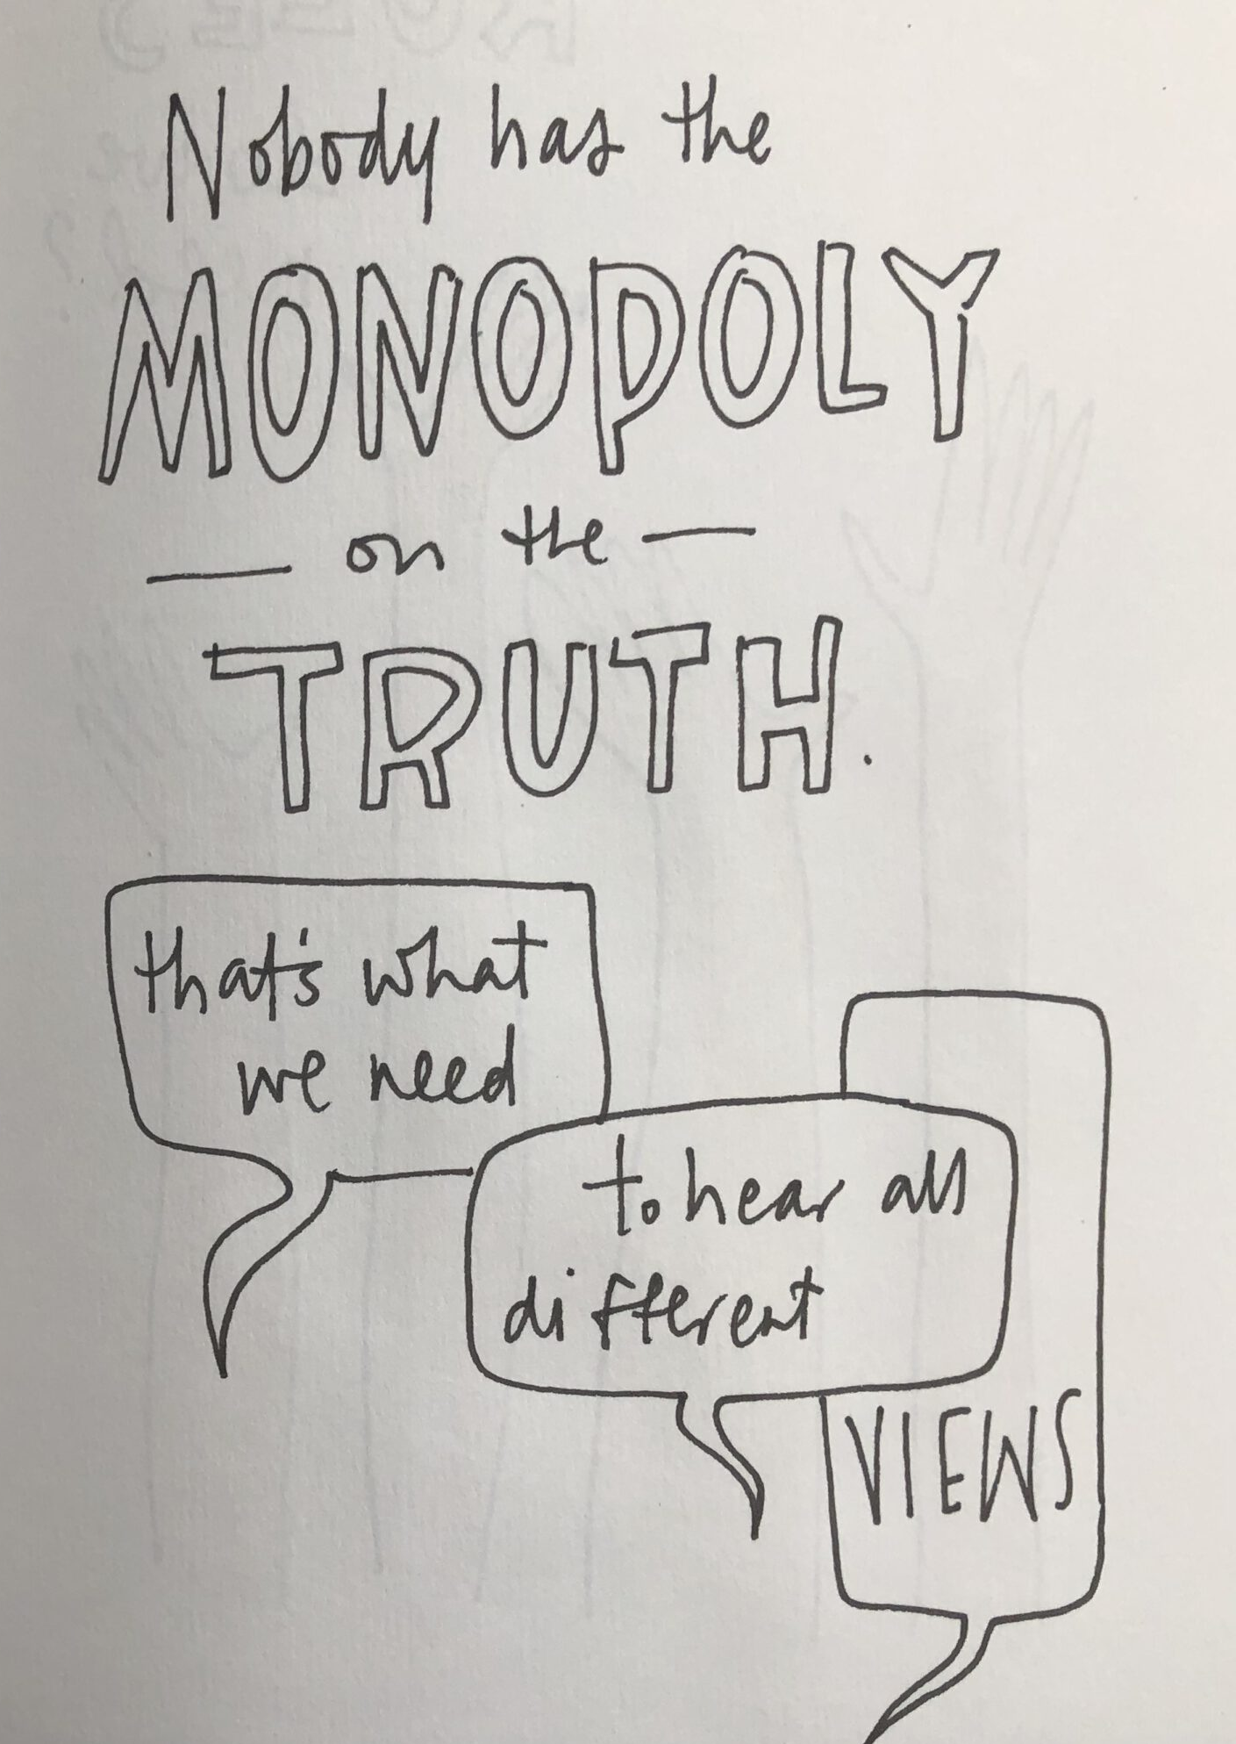
What peers bring in!
Check in
Diversity
Investing in relationships
Divergent thinking
Making thinking visible
Using the wisdom of the minority
Conflict
Wrap up
“Whatever comes to mind is at least interesting to put on the table. It is based on what you have learned, experienced, read, heard …”

Slide 17
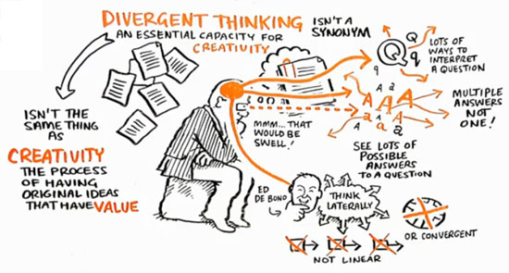
Sir Ken Robinson
Notes:
Lateral thinking challenges assumptions, connects unrelated concepts, and uses techniques such as random input to break through entrenched thinking patterns and arrive at new insights.

Slide 18
Basic technique
Ask a question / suggestion
Let group members first write their ideas down
List them & discuss
NOT: start to talk ➔ one idea “contaminates” or directs group thinking
Necessary: safe space (see investing in relationship)
Notes:
Verwijs naar wat ik deed. Vragen laten antwoorden maar deze nog niet tonen.

Slide 19
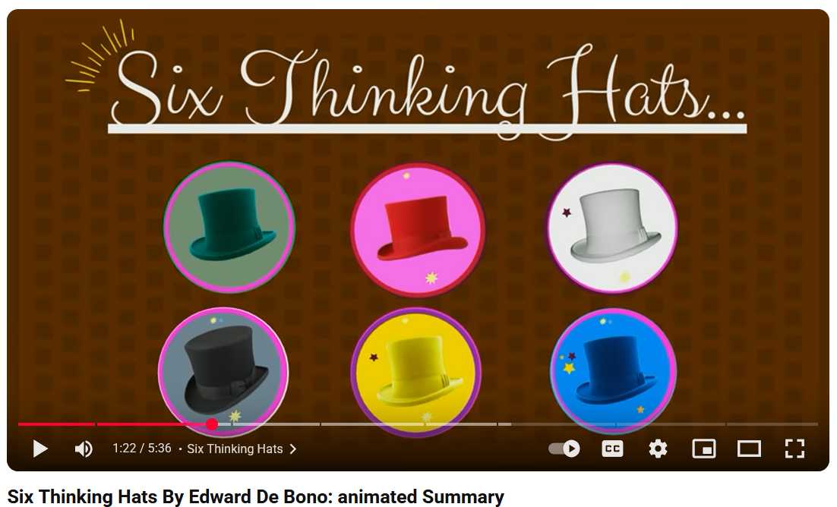
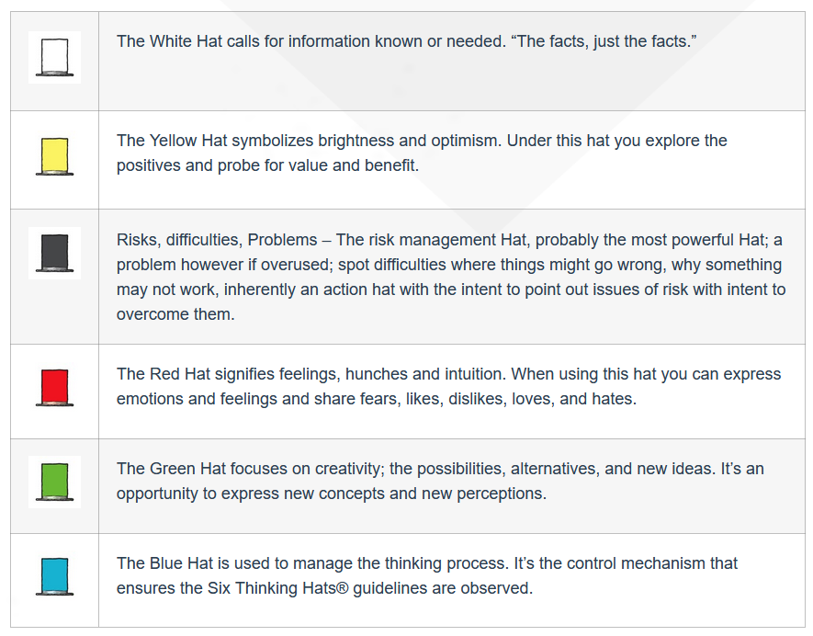
6 thinking hats of de bono
E.g. decision on research method(s)
Notes:
https://www.debonogroup.com/services/core-programs/six-thinking-hats/
https://www.youtube.com/watch?v=W3aWduLGM5I

Slide 20
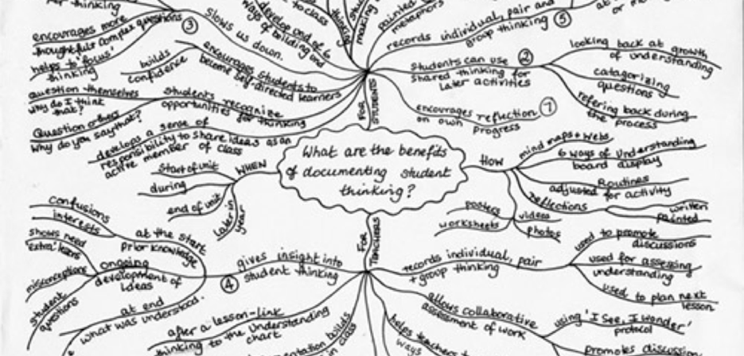
Check in
Diversity
Investing in relationships
Divergent thinking
Making thinking visible
Using the wisdom of the minority
Conflict
Wrap up

Slide 21
Externalise thinking
… is a research-based educational approach from Harvard's Project Zero, developed by Ron Ritchhart, Mark Church, and Karin Morrison, that helps students and teachers externalize their thoughts through practices like thinking routines, documentation, and questioning to improve understanding and engagement. This approach uses specific routines to make the internal processes of thinking visible, allowing for them to be directed, refined, and reflected upon
https://pz.harvard.edu/projects/visible-thinking

Slide 22
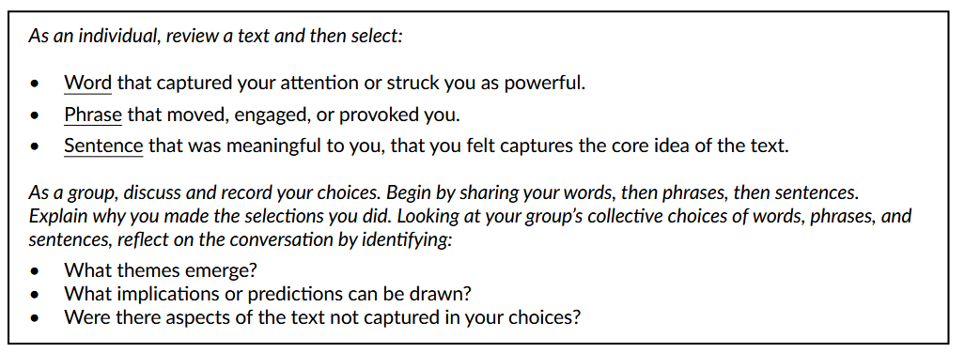
WORD-PHRASE-SENTENCE
e.g. reading a tekst, watching a movie and discuss in group
Source: https://pz.harvard.edu/sites/default/files/Word-Phrase-Sentence.pdf

Slide 23
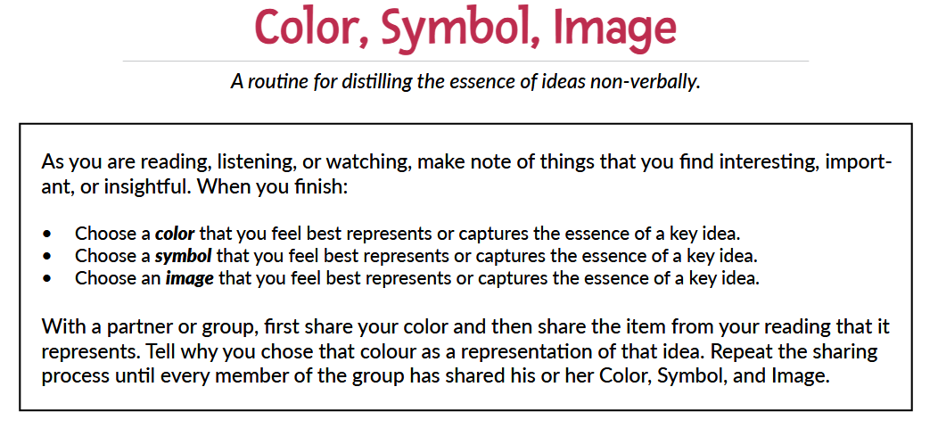
https://pz.harvard.edu/sites/default/files/Color%20Symbol%20Image_1.pdf
Notes:
It can bring up more that factual knowledge: beliefs, feelings, connections…
Drawing valuable as well
Eventueel opdracht: qualitative research

Slide 24
Deep democracy (DD)
Check in
Diversity
Investing in relationships
Divergent thinking
Making thinking visible
Using the wisdom of the minority
Conflict
Wrap up
Arnold Mindell
https://en.wikipedia.org/wiki/Arnold_Mindell
Mirna and Greg Lewis
https://www.lewisdeepdemocracy.com/?srsltid=AfmBOop3FNTPFIYqQvbEd3GUJkUz-E-ebvTvizxw13MGHfQxxyb5a-8q

Slide 25
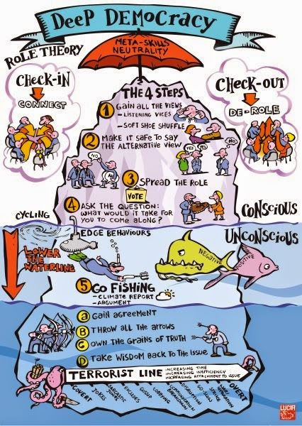
The wisdom of the minority is brought in
Conflict is useful: address issues “under the waterline”
An EU-project UCLL is involved in on Deep democracy:
https://creative-resilience.eu/nl/homepage_be/

Slide 26
A DD Decision making method
Collect all ideas, viewpoints
Empower the minority voices: look for “No”
Spread the “No”
    Who recognizes this?
    Even when similar in stead of exactly the same
VOTE
    Unanimity? Go for it!
    Majority? Step 4
    Group members are divided: give space for lobbying and vote again
Ask minority what is needed to come along with the decision

Slide 27
Exercise
You will join a group of 5 (Teams break out room)
Your group work will be 80% of the assessment of a small course in your programme
Decision to take: how are you going to meet? (how often, what days, …)
Take the 5 steps to make a decision in about 10 minutes

Slide 28
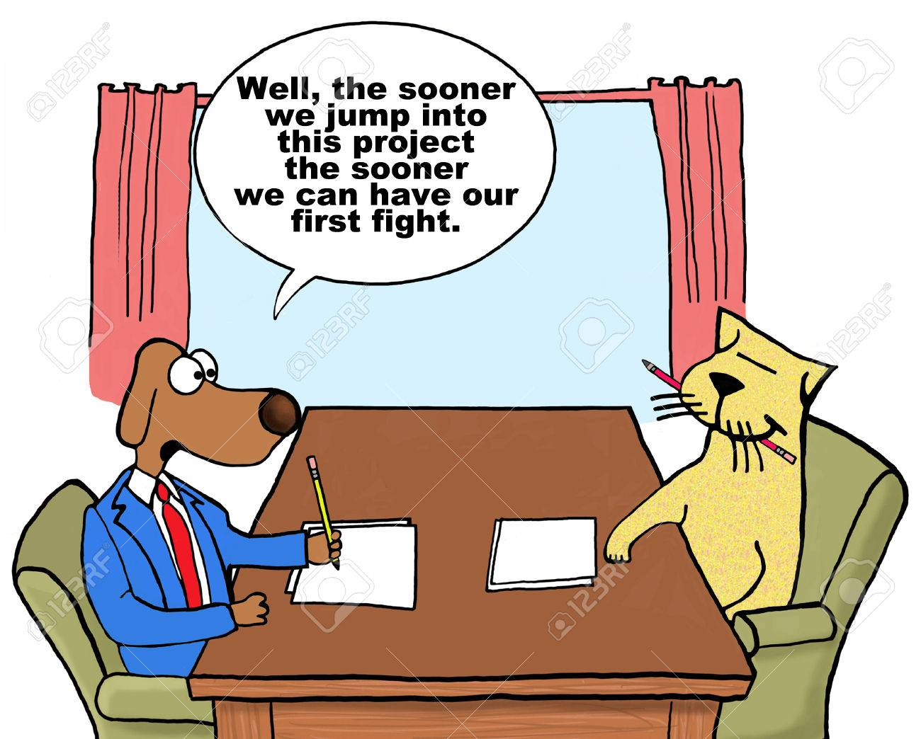
Check in
Diversity
Investing in relationships
Divergent thinking
Making thinking visible
Using the wisdom of the minority
Conflict
Wrap up

Slide 29
Passing a message
Speak from “I”
Describe behavior
Describe the effect it has on you / the group
Describe the desired behavior
Ask help to understand where it is coming from
Ask what the person would need to move further constructively
Notes:
Address as soon as possible
If the destructive behavior is not resolved: look for mediation

Slide 30
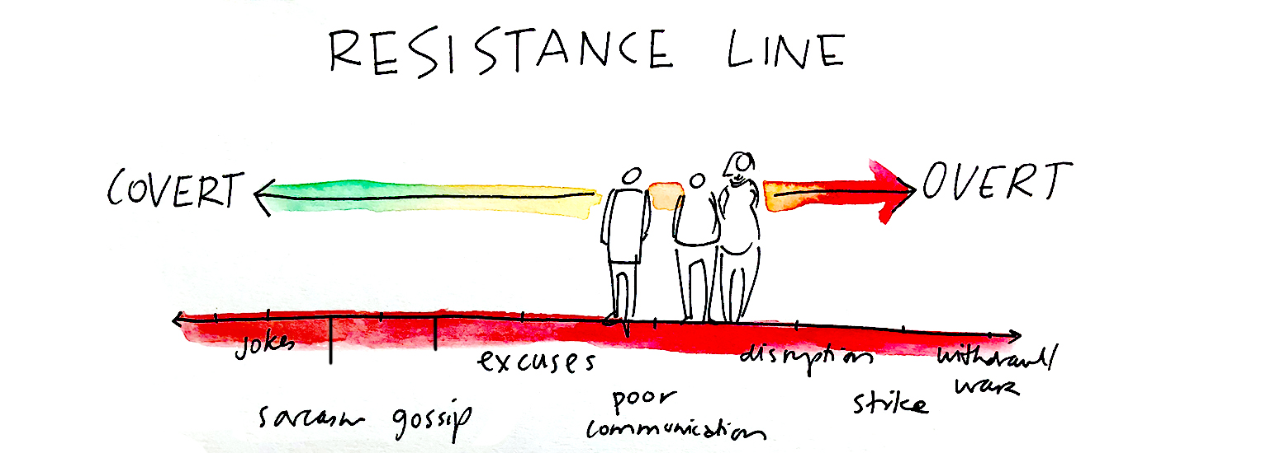
Cf. deep democracy
Notes:
Sabotage in groups: behaviors
What plays under th waterline? Bring it in to advance the work

Slide 31
Learning outcomes
To identify various characteristics in which people can differ and their possible effect
To name factors of success and difficulties in group work
To identify three things to build relationships in a group work
To make room for divergent thinking in group work
To make (diverse) thinking visible
To explain how the wisdom of the whole group can be used
To have courage to address difficulties/conflict
To assess the input here for your context

Slide 32


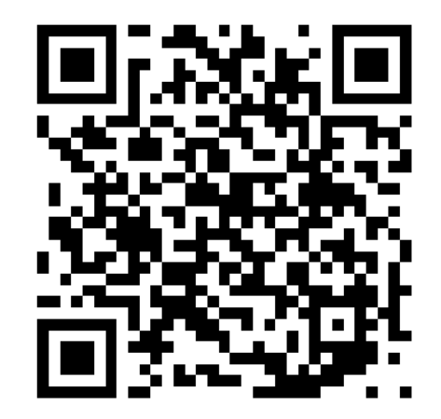
Check out
Check in
Diversity
Investing in relationships
Divergent thinking
Making thinking visible
Using the wisdom of the minority
Conflict
Wrap up
Go to : www.wooclap.com
Code: JANYDR

